Slide 1


Traffic Light Detection
D0965719 陳心榆 Shelly
D0969611 簡智霖 Chih Lin Chien

Slide 2

Motivation / Background
There are many accidents occur because of driving distractions and poor vision.
Therefore, we want to try to automatically detect traffic lights.
Application:
1. Self-driving
2. Reminding drivers to pay attention to what lights are now
3. Color blind
Notes:
We often hear in the news that traffic accidents occur because of driving distractions, poor vision and other reasons.
Today, with the development and progress of rtificial intelligence, cars can no longer be controlled by humans, but can be completely controlled by computers.
Therefore, we want to try to automatically detect traffic lights, which can be applied to self driving, knowing whether to stop or going forward, or reminding drivers to pay attention to what lights are now, and stop at red lights, so as to avoid some violations or accidents.
Or it can also be used by people who are colorblind, and then they can now know which color of light it is.

Slide 3
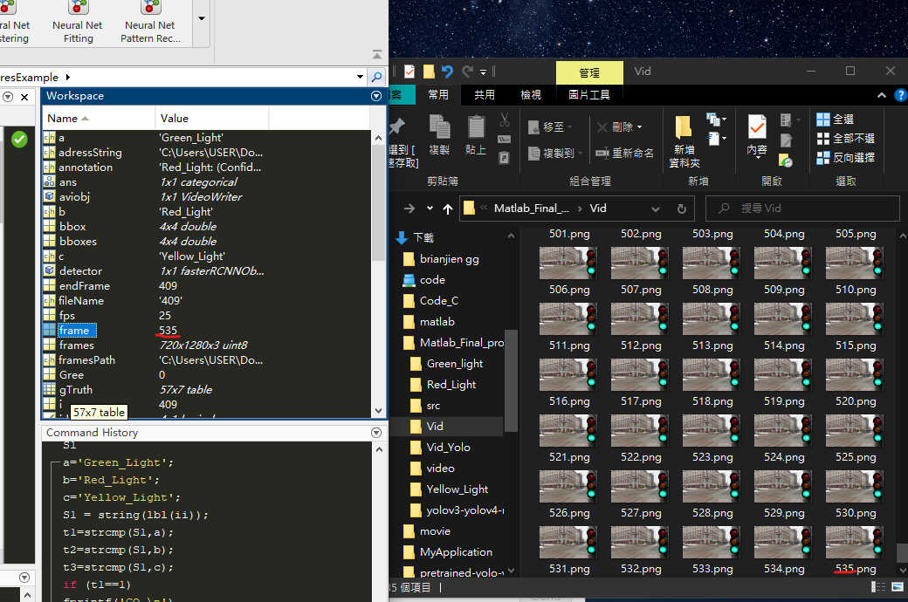
Proposed Method
Video Frame
-To make the target detectable, we convert the video into frames, use the photo to detect, then save the detected photo in the folder, and finally synthesize the video.
Notes:
Video Frame
-In order to make the target detectable, we convert the video into many frames, use the photo to detect, then save the detected photo in the folder, and finally synthesize the video.
In this picture is the result of converting our video into a frame.
The videos we found are converted into 575 frames.

Slide 4
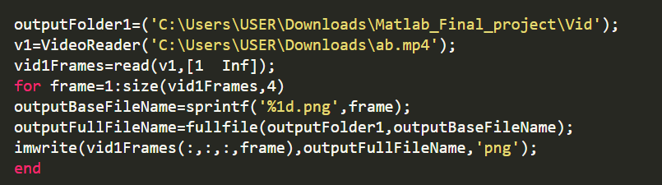
Code
The first step is to read video and convert it to frames.
Notes:
OutputBaseFilename：安裝檔檔案名稱
fullfile replaces all forward slashes (/) with backslashes (\) on Windows. On UNIX® platforms, the backlash (\) character is a valid character in file names and is not replaced. fullfile does not trim leading or trailing separators.
We use VideoReader to read files containing video data, and use read function to read from the first frame to the end of the video file.
Then, store the frames and name the files by number.
Next line, fullfile function is to replace all forward slashes (/) with backslashes (\) , because the backlash (\) character is a valid character in file names and is not replaced.
fullfile does not trim leading or trailing separators.

Slide 5
Proposed Method
Object Detection :
Two-stage vs One-stage
One-stage:
In order to improve the two-stage detection speed problem.
To perform object position detection and classification at the same time.
Representative algorithms include YOLO and SSD.
Two-stage:
The main algorithm in the early algorithm.
Representative algorithms include R-CNN, Fast-RCNN and Faster RCNN.
Notes:
Object detection is the task of detecting instances of objects of a certain class within an image.
And it can be divided into two categories, two stage and one stage
Two stage is the main algorithm in the early algorithm.
Because the object position detection and classification are carried out separately, there is a certain speed limit.
And the representative algorithms include RCNN, Fast RCNN, and Faster RCNN
One stage is to improve the two stage speed problem.
And it can perform object position detection and classification at the same time.
Representative algorithms include YOLO and SSD.

Slide 6
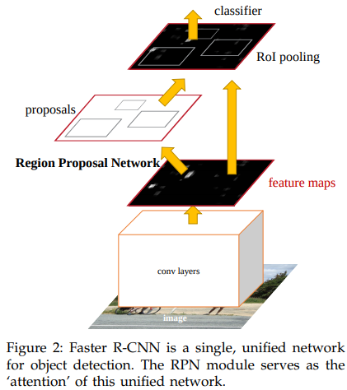
Proposed Method
Faster RCNN
Conv layers
Region Proposal Network: The biggest difference from Fast R-CNN is that RPN is used to generate region proposals and uses bbox regression to correct the position information of anchors to obtain more accurate positions.
RoIPooling
Classification
Notes:
I will introduce Faster RCNN,
It can be divided into four parts.
First is convolution layers. Resize the input image and record the rescale factor as the information required for the proposal layer to align the position of RoIPooling.
Second is region proposol network (RPN), The biggest difference from Fast R-CNN is that RPN is used to generate region proposals, and uses bbox regression to correct the position information of anchors to obtain more accurate positions.
Third is rolpooling, collect the results of feature maps and RPN, and send the information to fully connected layer for training after comprehensive information.
Last is classification, use rolpooling input values for classification and bbox regression to obtain the best object position,

Slide 7
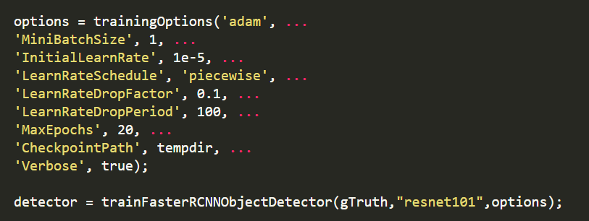
Code
This part is the training setting. We set the LearnRateSchedule to piecewise, and the learning rate will be multiplied by a factor whenever a certain number of epochs have passed.
Notes:
This part is the training method, in this program, we choose resnet101 to train.
"piecewise" - the learning rate is multiplied by a factor whenever a certain number of epochs have passed. The multiplication factor is controlled by the parameter "LearnRateDropFactor", and the number of epochs between multiplications is controlled by "LearnRateDropPeriod".
'LearnRateDropFactor'
This parameter only applies when "LearnRateSchedule" is set to "piecewise". This is a multiplier factor that is applied to the learning rate every time a certain number of epochs pass.
The default value is 0.1.
'LearnRateDropPeriod'
As before, this parameter only applies when "LearnRateSchedule" is set to "piecewise". Each time this number of epochs passes, the learning rate drop factor will be applied to the global learning rate. The default value is 10.
‘CheckpointPath’
Path to save the checkpoint network. When specified, the software saves the checkpoint network after each epoch. If not specified, no checkpoints will be saved.

Slide 8
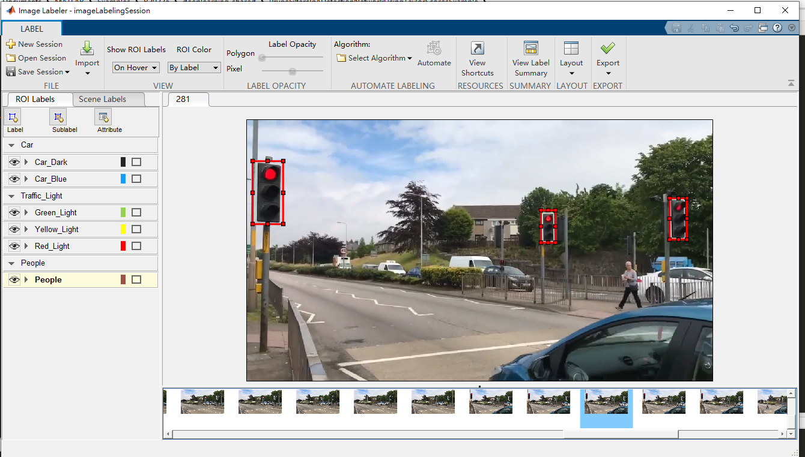
Code
Notes:
we use the image labeler to mark the data in the train images, and then store it as gTruth.

Slide 9
Code
Then, train the detector, we choose resnet101 to train.
Notes:
Next, trains a Faster R-CNN object detector using deep learning. We can train a Faster R-CNN detector to detect multiple object classes.
Use the data we labeled in gTruth. And in this program, we choose resnet101 to train.

Slide 10
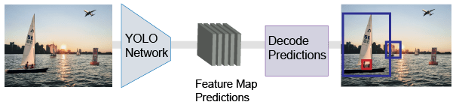
Proposed Method
Yolov2: A single-stage real-time object detection model.
-In terms of speed, YOLO is one of the best models in object recognition, able to recognize objects and process frames at the rate up to 150 FPS for small networks.
Notes:
Yolov2: A single-stage real-time object detection model.
The YOLO v2 model runs a deep learning CNN on an input image to produce network predictions. The object detector decodes the predictions and generates bounding boxes.
-In terms of speed, YOLO is one of the best models in object recognition, able to recognize objects and process frames at the rate up to 150 FPS for small networks.

Slide 11
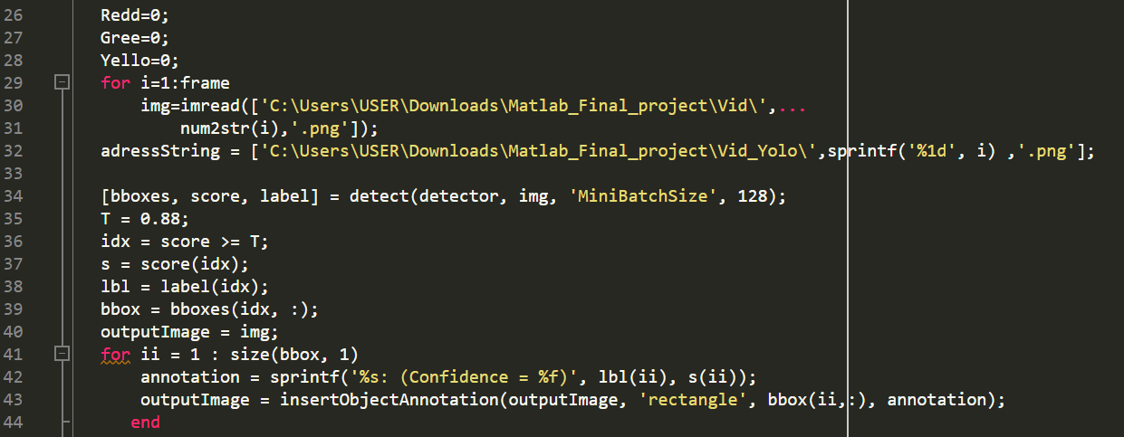
Code
In this step, let the machine automatically distinguish and frame the features. If the accuracy is less than 0.88, it will not be displayed.

Slide 12
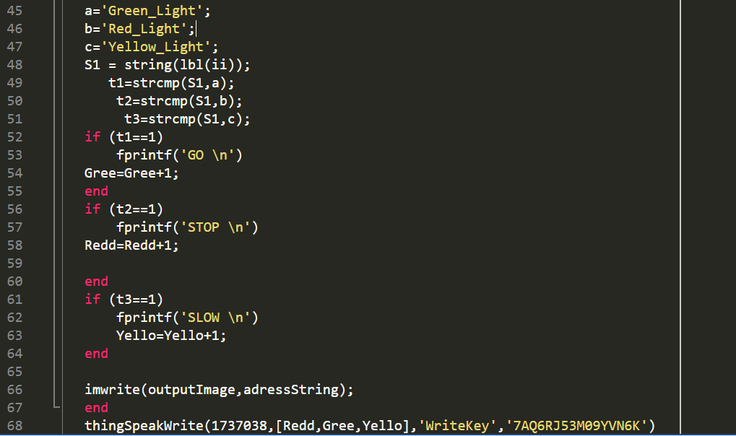
Code
Then, to determine whether the label is the same, use strcmp function to compare s1 and a,b,or c and returns 1 (true) if the two are identical and 0 (false) otherwise.
And use imwrite function to output the image, and then upload to thingspeak.
Notes:
to determine whether the label is the same, use strcmp function to compare s1 and a,b,or c and returns 1 (true) if the two are identical and 0 (false) otherwise.
If it is green light, print GO, if it is red light, print STOP, if it is yellow light, print SLOW
use imwrite function to output the image, and then upload to thingspeak.

Slide 13
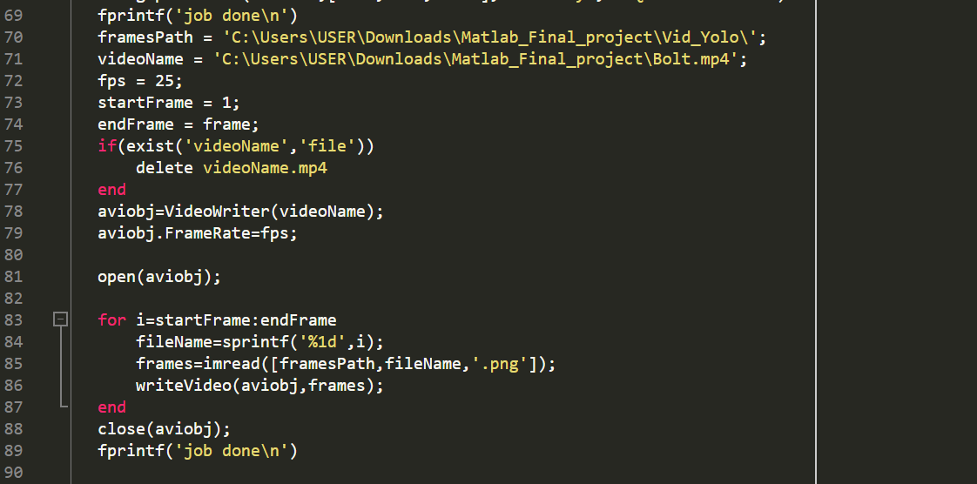
Code
In this step, we set fps(how many frames in 1 second) and combine all the images into one video. Output the video as an avi format

Slide 14
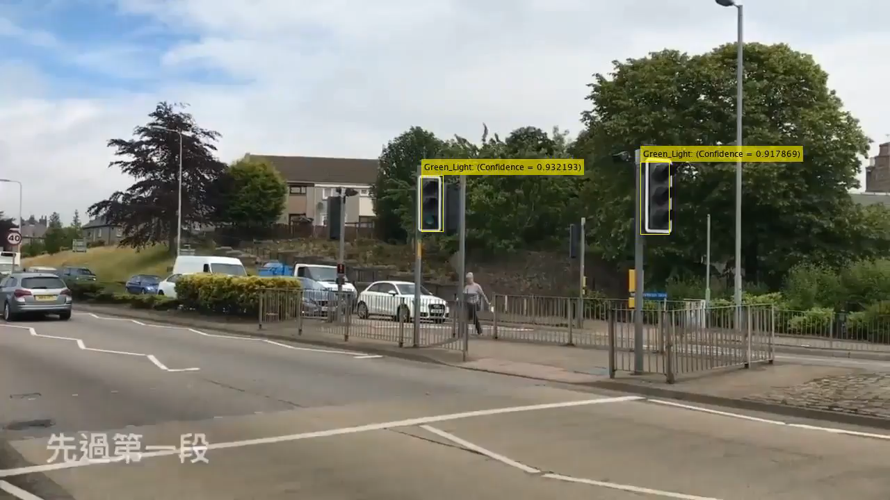
Result

Slide 15
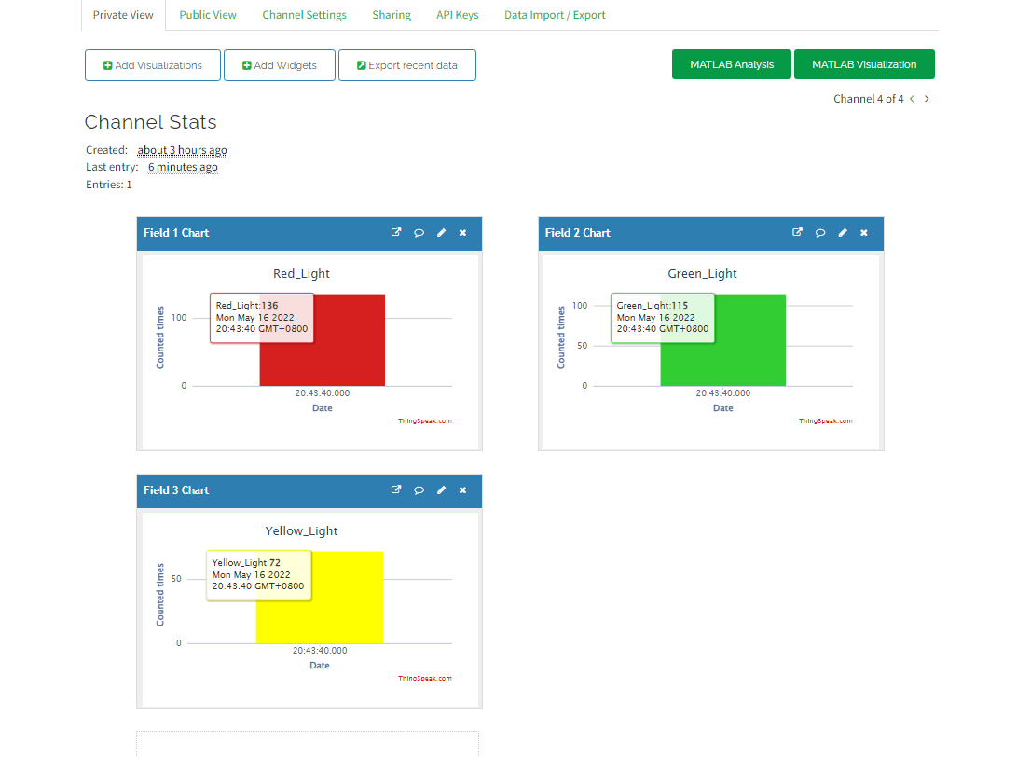
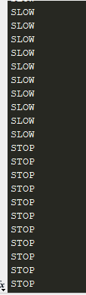
Result
Calculate the number of times with the program and upload it to thingspeak, so we can see the cumulative number of red, yellow, and green lights.

Slide 16
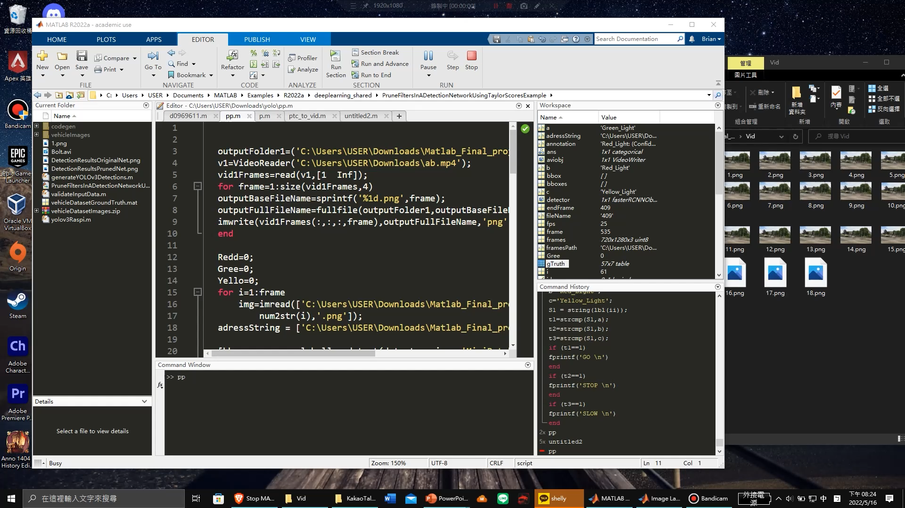
Demonstraction

Slide 17
Conclusion
In this project we made real-time detection in image, and divided videos into frames, after training and adding label in images. The program will combine those images and turn into videos. Finally, calculate counted times and upload it on thing speak.

Slide 18
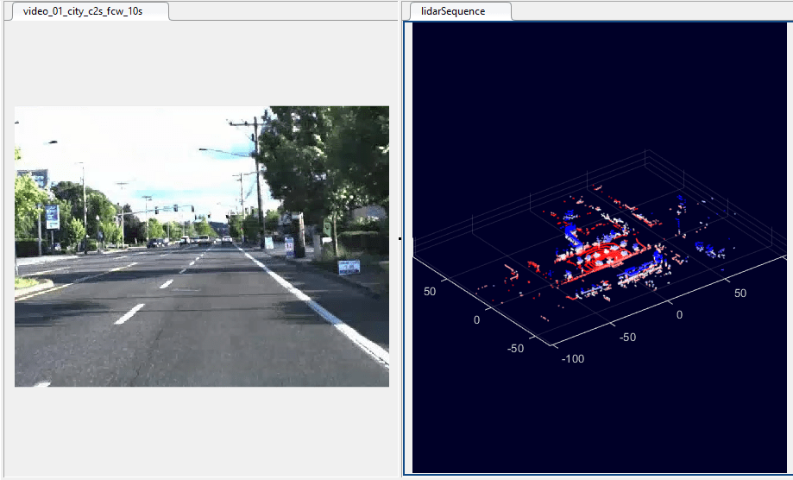
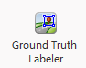
Future works
They can be applied to self-driving, helping to recognize images from different angles, and training machines to remember traffic lights. After the machine recognizes that it encounters a red light, it will automatically stop.

Slide 19
The End

